Slide 1
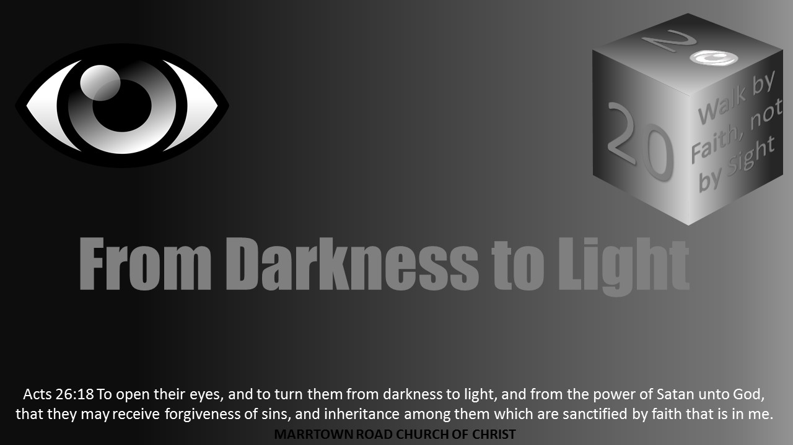


Slide 2
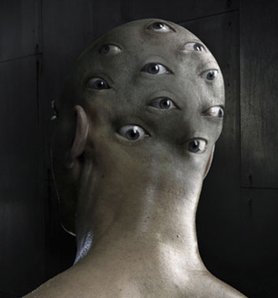
Darkness Lesson 13
The Devil's Dark Distortions:
Division
Everyone Is Not An Eye

Slide 3

Introduction
Humans start deciding that one difference is better or worse than another, deciding they are better than someone else.
Division is a pride that yields prejudice, racism, arrogance, and self-righteousness, among others.
Division is still common among brethren both between congregations and within a congregation.
Notes:
I am not certain when it happens in humans. Yet, we see it in so many ways. When we start deciding that one difference is better or worse than another. Eventually a person thinks or acts like they are better than someone else. Their different is better than someone else’s different. Division is a pride that yields prejudice, racism, arrogance, and self-righteousness, among others. Division is still common among brethren both between congregations and within a congregation. Often many try to justify division because of "doctrinal soundness," and one can be sure that sometimes division is born out of doctrinal issues. Even when sin is involved, christians must act knowing souls could be lost. However, more often, it is this author's observation that division is caused by differences between leading personalities. Thomas Campbell expressed that many divisions in the church are matters of “private opinion or human invention.”

Slide 4
Introduction
Often many try to justify division because of "doctrinal soundness.”
Sometimes division is born out of doctrinal issues.
Christians must act knowing souls could be lost.
Division is often caused by differences between leading personalities.
Thomas Campbell expressed that many divisions in the church are matters of “private opinion or human invention.”
Notes:
I am not certain when it happens in humans. Yet, we see it in so many ways. When we start deciding that one difference is better or worse than another. Eventually a person thinks or acts like they are better than someone else. Their different is better than someone else’s different. Division is a pride that yields prejudice, racism, arrogance, and self-righteousness, among others. Division is still common among brethren both between congregations and within a congregation. Often many try to justify division because of "doctrinal soundness," and one can be sure that sometimes division is born out of doctrinal issues. Even when sin is involved, christians must act knowing souls could be lost. However, more often, it is this author's observation that division is caused by differences between leading personalities. Thomas Campbell expressed that many divisions in the church are matters of “private opinion or human invention.”
4

Slide 5
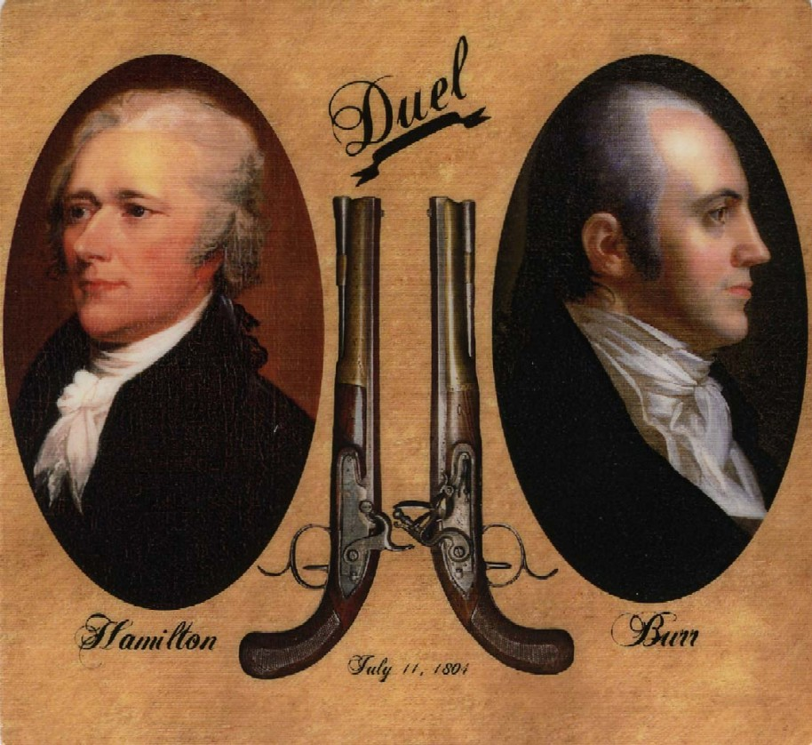
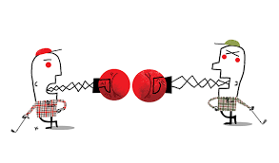
Introduction
If one is on social media such as Facebook, one has probably seen division.
  Civil discourse is rare, and name calling and fighting words are too common, resulting in an acrimonious anecdoche.
American politics seems to be rich in this approach as well. Trying to solve problems together seems to be forgotten for “Let’s get them [the other party]!”
And, that attitude was among our founding fathers, simply recall the dueling Burr and Hamilton.
In 2018, two men in Florida combined politics and Facebook. They finally met, and one killed the other before they even spoke in person
Notes:
If one is on social media such as Facebook, one has probably seen division. Civil discourse is rare, and name calling and fighting words are too common, resulting in an acrimonious anecdoche. American politics seems to be rich in this approach as well. Trying to solve problems together seems to be forgotten for “Let’s get them [the other party]!” And, that attitude was among our founding fathers, simply recall the dueling Burr and Hamilton. In 2018, two men in Florida combined politics and Facebook. They finally met, and one killed the other before they even spoke in person.

Slide 6
Eyes and Ears
A few decades back the Donahue show had Jane Elliott, who came to the show in a social experiment.
She appeared to express the supremacy of brown eyed people over all others.
It took the audience a while to figure what she was saying. She presented "evidences" to blue-eyed folks’ inferiority.
She had audience members buying in before she revealed her real point about racism.
Many might take exception to her technique and her conclusions, but Elliott made a powerful point about how humans will divide over anything and bash a target group.

Slide 7
Eyes and Ears
People will use anything to divide and decide one group is better than the other.
In truth, individuals have talents different than others. One skill or status may be more prized by society, but it takes all to make a church function properly.
The differences in the church should be embraced as each person fills a place or niche in service and glorifying of God.
Often these divisions are more and more inflammatory, spreading the disease. Not listening to gossip and divisive discussion is the responsibility of children of God.
Notes:
7

Slide 8
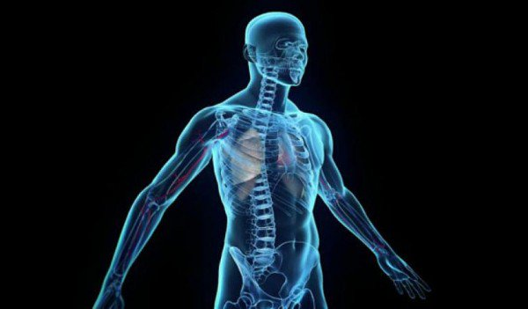
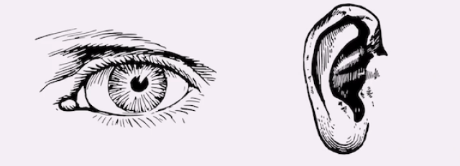
Eyes and Ears
1 Corinthians 12:14-27 “For the body is not one member, but many. If the foot shall say, Because I am not the hand, I am not of the body; is it therefore not of the body? And if the ear shall say, Because I am not the eye, I am not of the body; is it therefore not of the body? If the whole body were an eye, where were the hearing? If the whole were hearing, where were the smelling? But now hath God set the members every one of them in the body, as it hath pleased him. And if they were all one member, where were the body? But now are they many members, yet but one body. And the eye cannot say unto the hand, I have no need of thee: nor again the head to the feet, I have no need of you. Nay, much more those members of the body, which seem to be more feeble, are necessary: And those members of the body, which we think to be less honorable, upon these we bestow more abundant honour; and our uncomely parts have more abundant comeliness. For our comely parts have no need: but God hath tempered the body together, having given more abundant honour to that part which lacked: That there should be no schism in the body; but that the members should have the same care one for another. And whether one member suffer, all the members suffer with it; or one member be honoured, all the members rejoice with it. Now ye are the body of Christ, and members in particular.”
Paul teaches that God does not want division, but Christians should have the same care one for another
Notes:
In 1 Corinthians 12:14-27, Paul was inspired by the Holy Spirit to write, “For the body is not one member, but many. If the foot shall say, Because I am not the hand, I am not of the body; is it therefore not of the body? And if the ear shall say, Because I am not the eye, I am not of the body; is it therefore not of the body? If the whole body were an eye, where were the hearing? If the whole were hearing, where were the smelling? But now hath God set the members every one of them in the body, as it hath pleased him. And if they were all one member, where were the body? But now are they many members, yet but one body. And the eye cannot say unto the hand, I have no need of thee: nor again the head to the feet, I have no need of you. Nay, much more those members of the body, which seem to be more feeble, are necessary: And those members of the body, which we think to be less honorable, upon these we bestow more abundant honour; and our uncomely parts have more abundant comeliness. For our comely parts have no need: but God hath tempered the body together, having given more abundant honour to that part which lacked: That there should be no schism in the body; but that the members should have the same care one for another. And whether one member suffer, all the members suffer with it; or one member be honoured, all the members rejoice with it. Now ye are the body of Christ, and members in particular.” Paul teaches that God does not want division, but christians should have the same care one for another

Slide 9
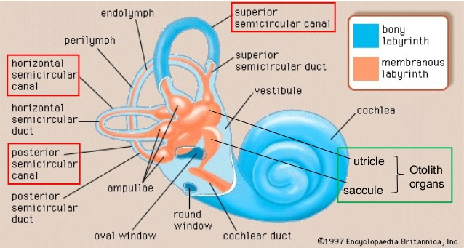
Vestibulo-ocular Reflex
The vestibular system of the ear is necessary for proper eye movements. The fluid filled canals of the vestibular system respond to the inertial forces produced by changes in speed and direction of movement. This combined set of information from the eyes and ears is called the vestibulo-ocular system.
If one looks at an object and rock their head up and down or left to right, the object remains focused and centered if their VOR is normal. This allows humans to track and attend to many tasks, even if the object or the person are both moving. If this was not true, then walking and driving would be almost impossible.
Notes:
Vestibulo-ocular Reflex
The human body has a kinesthetic system. This is the body’s own awareness of itself. In humans, the vestibular system as part of human ear allows persons to have a balance system, as part of the kinesthetic system. In a 2017 experiment, an earthquake machine was used to illustrate how the visual system and middle ear work together. The vestibular system of the ear is necessary for proper eye movements. The fluid filled canals of the vestibular system respond to the inertial forces produced by changes in speed and direction of movement. This combined set of information from the eyes and ears is called the vestibulo-ocular system.
The vestibulo-ocular reflex (VOR) are the reflexes that connect the inner ear and the muscles that move your eyes. The two junctions between nerves along this path make it very fast. This allows humans to focus and move their eyes and head quickly. When one moves their head, the vestibular apparatus in the inner ear senses the precise direction and speed of that movement telling the brain. The brain uses this to instruct the eye muscles to counter the head movements and keep the focus on the object of attention. If one looks at an object and rock their head up and down or left to right, the object remains focused and centered if their VOR is normal. This allows humans to track and attend to many tasks, even if the object or the person are both moving. If this was not true, then walking and driving would be almost impossible. This system can break down because of the inner ears, the transmitting nerves, improper processing by the brain, poor control of the eye muscles by the brain, or the eye muscles themselves. A commonly employed test of the VOR is the called the caloric test or sometimes called the COWS test when cold or warm water is poured into an ear looking for the appropriate eye movement as the water causes a small amount of endolymph in the lateral semicircular canal to move and causes the eyes to move. Vestibulo-ocular problems are frequent after traumatic brain injury. When this system does not work properly, it can be very difficult for a person to function. It can take a person who has suffered traumatic brain injury years to make any progress when this system has been injured. Optometrists often use prisms in lenses to move the image to an eye (instead of the eye moving to align itself) to help individuals with these problems. Christians need to use the prism of eternity to see the eternal rather than the temporal, the spiritual rather than the carnal.
The ears and eyes work together in another way. The eyes often start their tracking with the ears. In fact, the ears start to move (internally) in the direction of the movement of the eyes before the eyes move. This also allows the brain to predict what one will see. Specifically, the ear drums move slightly before and with the eyes in sync with each other. One's hearing allows the brain to make predictions. If a person’s eyes are closed and they hear a sound, the brain identifies and predicts the direction of the sound for the eyes. It activates the same areas of the brain as though it had seen a bird when all that happened was that a person heard a bird tweet when their eyes were closed. Clearly, the eyes and ears are interconnected and depend on their best work together rather than apart.

Slide 10
Vestibulo-ocular Reflex
Optometrists often use prisms in lenses to move the image to an eye (instead of the eye moving to align itself) to help individuals with these problems. Christians need to use the prism of eternity to see the eternal rather than the temporal, the spiritual rather than the carnal.
Clearly, the eyes and ears are interconnected and depend on their best work together rather than apart.
Notes:
Vestibulo-ocular Reflex
The human body has a kinesthetic system. This is the body’s own awareness of itself. In humans, the vestibular system as part of human ear allows persons to have a balance system, as part of the kinesthetic system. In a 2017 experiment, an earthquake machine was used to illustrate how the visual system and middle ear work together. The vestibular system of the ear is necessary for proper eye movements. The fluid filled canals of the vestibular system respond to the inertial forces produced by changes in speed and direction of movement. This combined set of information from the eyes and ears is called the vestibulo-ocular system.
The vestibulo-ocular reflex (VOR) are the reflexes that connect the inner ear and the muscles that move your eyes. The two junctions between nerves along this path make it very fast. This allows humans to focus and move their eyes and head quickly. When one moves their head, the vestibular apparatus in the inner ear senses the precise direction and speed of that movement telling the brain. The brain uses this to instruct the eye muscles to counter the head movements and keep the focus on the object of attention. If one looks at an object and rock their head up and down or left to right, the object remains focused and centered if their VOR is normal. This allows humans to track and attend to many tasks, even if the object or the person are both moving. If this was not true, then walking and driving would be almost impossible. This system can break down because of the inner ears, the transmitting nerves, improper processing by the brain, poor control of the eye muscles by the brain, or the eye muscles themselves. A commonly employed test of the VOR is the called the caloric test or sometimes called the COWS test when cold or warm water is poured into an ear looking for the appropriate eye movement as the water causes a small amount of endolymph in the lateral semicircular canal to move and causes the eyes to move. Vestibulo-ocular problems are frequent after traumatic brain injury. When this system does not work properly, it can be very difficult for a person to function. It can take a person who has suffered traumatic brain injury years to make any progress when this system has been injured. Optometrists often use prisms in lenses to move the image to an eye (instead of the eye moving to align itself) to help individuals with these problems. Christians need to use the prism of eternity to see the eternal rather than the temporal, the spiritual rather than the carnal.
The ears and eyes work together in another way. The eyes often start their tracking with the ears. In fact, the ears start to move (internally) in the direction of the movement of the eyes before the eyes move. This also allows the brain to predict what one will see. Specifically, the ear drums move slightly before and with the eyes in sync with each other. One's hearing allows the brain to make predictions. If a person’s eyes are closed and they hear a sound, the brain identifies and predicts the direction of the sound for the eyes. It activates the same areas of the brain as though it had seen a bird when all that happened was that a person heard a bird tweet when their eyes were closed. Clearly, the eyes and ears are interconnected and depend on their best work together rather than apart.
10

Slide 11
Division in The Early Church
Division existed in the New Testament church, and the Holy Spirit inspired the authors to address this issue, reminding them of the problem of division as these saints were growing and transforming.
Corinth church comes to mind first because of Paul’s letter to them.
Another example is the Jerusalem church with the Greek-Jewish division.
Division caused by the Judaizing teachers, especially as seen at Galatia.
Fostering of unity needed in Ephesians as well.
Philippians to be of like minded while pursing the same purpose.
Notes:
Division in the Early Church
Clearly, division existed in the New Testament church, and the Holy Spirit inspired the authors to address this issue, reminding them of the problem of division as these saints were growing and transforming. As one reads the New Testament, one can see evidence of division problems. Perhaps, the Corinth church comes to mind first because of Paul’s letter to them. Another example is the Jerusalem church with the Greek-Jewish division. And, what Bible student could forget the division caused by the Judaizing teachers, especially as seen at Galatia. Paul was focusing on fostering of unity in Ephesians as well. The Holy Spirit’s inspiration for the church of Philippi called for them to be of like minded while pursing the same purpose. Colossians was written to a church that had division over keeping holy days, eating restrictions, and worship. The Thessalonian church had a division as some refused to work expecting others to care for their needs as they anticipated Chris’s return. Moreover, Paul had to leave Timothy in Ephesus to deal with doctrinal concerns as well as those who were imposing Jewish law. Further, he left Titus in Crete to deal with dividing issues. Peter’s second epistle deals with false teaching division. Third John notes Diotrophes who was hurting unity with his desire for power.

Slide 12
Division in The Early Church
Colossians was written to a church that had division over keeping holy days, eating restrictions, and worship.
Thessalonian church had a division as some refused to work expecting others to care for their needs as they anticipated Chris’s return.
Paul had to leave Timothy in Ephesus to deal with doctrinal concerns as well as those who were imposing Jewish law.
Titus left in Crete to deal with dividing issues.
Peter’s second epistle deals with false teaching division.
Third John notes Diotrophes who was hurting unity with his desire for power.
Notes:
Division in the Early Church
Clearly, division existed in the New Testament church, and the Holy Spirit inspired the authors to address this issue, reminding them of the problem of division as these saints were growing and transforming. As one reads the New Testament, one can see evidence of division problems. Perhaps, the Corinth church comes to mind first because of Paul’s letter to them. Another example is the Jerusalem church with the Greek-Jewish division. And, what Bible student could forget the division caused by the Judaizing teachers, especially as seen at Galatia. Paul was focusing on fostering of unity in Ephesians as well. The Holy Spirit’s inspiration for the church of Philippi called for them to be of like minded while pursing the same purpose. Colossians was written to a church that had division over keeping holy days, eating restrictions, and worship. The Thessalonian church had a division as some refused to work expecting others to care for their needs as they anticipated Chris’s return. Moreover, Paul had to leave Timothy in Ephesus to deal with doctrinal concerns as well as those who were imposing Jewish law. Further, he left Titus in Crete to deal with dividing issues. Peter’s second epistle deals with false teaching division. Third John notes Diotrophes who was hurting unity with his desire for power.
12

Slide 13
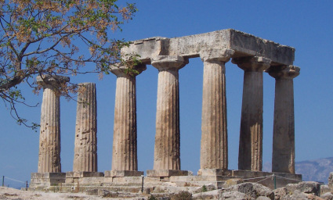
Division in The Early Church
The Roman empire, when the New Testament was penned, was a swirl of cultures and differences.
The New Testament church had people of very different backgrounds from the pagan idolaters to previously devout Jews.
Currently, a person will state a feeling of being disconnected from a congregation where they belong.
The basis of unity is scriptural and found in Christ.
Christians must oppose needless fighting, jealous factions, and strife. The lost will not be drawn to a place of fighting.
God unifies the church, but Christians need to have the attitude of unity and caring in obedience to Christ.
Notes:
The Roman empire, when the New Testament was penned, was a swirl of cultures and differences: Gentile and Greek, slave and free, male and female. (Picture is temple of Apollo at Corinth). Even the Jews had many different subgroups. The New Testament church had people of very different backgrounds from the pagan idolaters to previously devout Jews. There was a huge challenge to unify these individuals in churches. Churches here in the United States do not face differences as large in culturally or politically.
Nevertheless, one can observe in churches here how easily a person will state a feeling of being disconnected from a congregation where they belong. The basis of unity is scriptural and found in Christ. Christians must oppose needless fighting, jealous factions, and strife. The lost will not be drawn to a place of fighting. God unifies the church, but christians need to have the attitude of unity and caring in obedience to Christ.

Slide 14

Working Together In Love
In the Lord’s church, the ears, the eyes, and the hands as well as all other parts have to work together.
The church as the body of Christ has many members but only one body.
When one of member suffers, all suffer. When one of Christian rejoices, all rejoice (Romans 12:15-16).
In a most connected world of communications, real human connections should start with relationships with fellow children of Light at the congregation where they worship.
Christians are able to serve, accomplish, and glorify God so much more by serving and working together in brotherly love.
Notes:
Working Together In Love
In the Lord’s church, the ears, the eyes, and the hands as well as all other parts have to work together. God cares for humanity so much that even the hairs on one's head are numbered. The church as the body of Christ has many members but only one body. When one of member suffers, all suffer. When one of Christian rejoices, all rejoice (Romans 12:15-16). In a most connected world of communications, real human connections should start with relationships with fellow children of Light at the congregation where they worship. Christians are able to serve, accomplish, and glorify God so much more by serving and working together in brotherly love.

Slide 15
Working Together In Love
1 John 2:7-10 reads, “Brethren, I write no new commandment unto you, but an old commandment which ye had from the beginning. The old commandment is the word which ye have heard from the beginning. Again, a new commandment I write unto you, which thing is true in him and in you: because the darkness is past, and the true light now shineth. He that saith he is in the light, and hateth his brother, is in darkness even until now. He that loveth his brother abideth in the light, and there is none occasion of stumbling in him. But he that hateth his brother is in darkness, and walketh in darkness, and knoweth not whither he goeth, because that darkness hath blinded his eyes.”
Often, one hears brethren lament some division as having been over a concern of doctrine, but most know it was over a personality or pride point.
Children of Light must love and not hate each other.
Christians must endeavor to practice agape love, and God must come first.
Those who hate are blinded by darkness.
Notes:
1 John 2:7-10 reads, “Brethren, I write no new commandment unto you, but an old commandment which ye had from the beginning. The old commandment is the word which ye have heard from the beginning. Again, a new commandment I write unto you, which thing is true in him and in you: because the darkness is past, and the true light now shineth. He that saith he is in the light, and hateth his brother, is in darkness even until now. He that loveth his brother abideth in the light, and there is none occasion of stumbling in him. But he that hateth his brother is in darkness, and walketh in darkness, and knoweth not whither he goeth, because that darkness hath blinded his eyes.” Often, one hears brethren lament some division as having been over a concern of doctrine, but most know it was over a personality or pride point. Children of Light must love and not hate each other. Christians must endeavor to practice agape love, and God must come first. Those who hate are blinded by darkness.

Slide 16
God Unifies The Church
God created humanity in His image. Each soul is important to Him. He sacrificed His only begotten Son that He might bring salvation to all.
A person’s whatever is not as important as the salvation of their soul. Christians must be about sharing the gospel.
Division among Christians cannot be over the color of skin, weight, height, birthplace, economic status, educational background or preferred color of drapery.
Each person has inherent value as God created them in His image, and sacrificed the Christ to offer redemption for them.
God demonstrated his love, kindness, goodness, and light.
As a christian, one must teach their children that the eternal or things one cannot see are essential to life.

Slide 17
God Unifies The Church
Jesus desired that His followers would be united.
John 17:20-23 "Neither pray I for these alone, but for them also which shall believe on me through their word; That they all may be one; as thou, Father, art in me, and I in thee, that they also may be one in us: that the world may believe that thou hast sent me. And the glory which thou gavest me I have given them; that they may be one, even as we are one: I in them, and thou in me, that they may be made perfect in one; and that the world may know that thou hast sent me, and hast loved them, as thou hast loved me."

Slide 18
God Unifies The Church
The attitude of unity is seen in Ephesians 4:1-6
“I therefore, the prisoner of the Lord, beseech you that ye walk worthy of the vocation wherewith ye are called, With all lowliness and meekness, with longsuffering, forbearing one another in love; Endeavouring to keep the unity of the Spirit in the bond of peace. There is one body, and one Spirit, even as ye are called in one hope of your calling; One Lord, one faith, one baptism, One God and Father of all, who is above all, and through all, and in you all.”
For children of Light, oneness is in God and Christ.
Notes:
Further, the attitude of unity is seen in Ephesians 4:1-6: “I therefore, the prisoner of the Lord, beseech you that ye walk worthy of the vocation wherewith ye are called, With all lowliness and meekness, with longsuffering, forbearing one another in love; Endeavouring to keep the unity of the Spirit in the bond of peace. There is one body, and one Spirit, even as ye are called in one hope of your calling; One Lord, one faith, one baptism, One God and Father of all, who is above all, and through all, and in you all.” For children of Light, oneness is in God and Christ. The one body, the church, is where Christians are united. One spirit has revealed God’s word. There is one hope of heaven. Jesus Christ is our one Lord and authority. One faith is the doctrine of the Gospel. There is one baptism into Christ. There is one Father to be worshipped and glorified. This is how God unites christians.
Mt 16:8, Rom 12:5, 1 Cor 12:12, Eph 2:14-22, Col 3:15
1 Cor 2:9-13, John 16:14-15, 1 Cor 12:13, 2 Cor 11:2-4, 1 John 4:13
Eph 1:17-19, Col 1:3-6, Titus 1:1-3, Acts 15:11
Mt 28:18, Acts 10:36, 1 Cor 1:2, Eph 1:10
Gal 1:6-10, Eph 4:11-13, Jude 3, Titus 1:4, 2 Pet 1:1
1 Cor 12:13, Gal 3:26-28, Rom 6:3-4
1 Cor 8:6, 1 Jn 3:1-3, Rom 3:30

Slide 19
God Unifies The Church
For children of Light, oneness is in God and Christ.
The one body, the church, is where Christians are united. Mt 16:8, Rom 12:5, 1 Cor 12:12, Eph 2:14-22, Col 3:15
One Spirit has revealed God’s word. 1 Cor 2:9-13, John 16:14-15, 1 Cor 12:13, 2 Cor 11:2-4, 1 John 4:13
There is one hope of heaven. Eph 1:17-19, Col 1:3-6, Titus 1:1-3, Acts 15:11
Jesus Christ is our one Lord and authority. Eph 1:17-19, Col 1:3-6, Titus 1:1-3, Acts 15:11
One faith is the doctrine of the Gospel. Gal 1:6-10, Eph 4:11-13, Jude 3, Titus 1:4, 2 Pet 1:1
There is one baptism into Christ. 1 Cor 12:13, Gal 3:26-28, Rom 6:3-4
There is one Father to be worshipped and glorified. 1 Cor 8:6, 1 Jn 3:1-3, Rom 3:30
This is how God unites Christians.
Notes:
Further, the attitude of unity is seen in Ephesians 4:1-6: “I therefore, the prisoner of the Lord, beseech you that ye walk worthy of the vocation wherewith ye are called, With all lowliness and meekness, with longsuffering, forbearing one another in love; Endeavouring to keep the unity of the Spirit in the bond of peace. There is one body, and one Spirit, even as ye are called in one hope of your calling; One Lord, one faith, one baptism, One God and Father of all, who is above all, and through all, and in you all.” For children of Light, oneness is in God and Christ. The one body, the church, is where Christians are united. One spirit has revealed God’s word. There is one hope of heaven. Jesus Christ is our one Lord and authority. One faith is the doctrine of the Gospel. There is one baptism into Christ. There is one Father to be worshipped and glorified. This is how God unites christians.
Mt 16:8, Rom 12:5, 1 Cor 12:12, Eph 2:14-22, Col 3:15
1 Cor 2:9-13, John 16:14-15, 1 Cor 12:13, 2 Cor 11:2-4, 1 John 4:13
Eph 1:17-19, Col 1:3-6, Titus 1:1-3, Acts 15:11
Mt 28:18, Acts 10:36, 1 Cor 1:2, Eph 1:10
Gal 1:6-10, Eph 4:11-13, Jude 3, Titus 1:4, 2 Pet 1:1
1 Cor 12:13, Gal 3:26-28, Rom 6:3-4
1 Cor 8:6, 1 Jn 3:1-3, Rom 3:30
19

Slide 20

God Unifies The Church
The attitude needed to practice God’s unity starts with humbleness considering others first. 1 Peter 5:5-7, Phil 2:2-4, Rom 12:3
Gentleness and meekness are also part of the attitude of unity. James 3:13-18, James 1:21, 2 Cor 10:1-6
Longsuffering as illustrated in forbearance and patience is also needed. Rom 2:4, 1 Tim 1:16, 2 Pet 3:14-18. 2 Tim 4:1-5
It also requires love of one another. John 13:34-35, 1 Cor 13, 1 Peter 1:22, 1 Peter 3:8-11
The attitude of unity also requires diligence, not an approach of apathy and inaction.
Notes:
The attitude needed to practice God’s unity starts with humbleness considering others first. Gentleness and meekness are also part of the attitude of unity. Longsuffering as illustrated in forbearance and patience is also needed. It also requires love of one another. The attitude of unity also requires diligence, not an approach of apathy and inaction. 1 Peter 5:5-7, Phil 2:2-4, Rom 12:3
James 3:13-18, James 1:21, 2 Cor 10:1-6
Rom 2:4, 1 Tim 1:16, 2 Pet 3:14-18. 2 Tim 4;1-5
John 13:34-35, 1 Cor 13, 1 Peter 1:22, 1 Peter 3:8-11

Slide 21
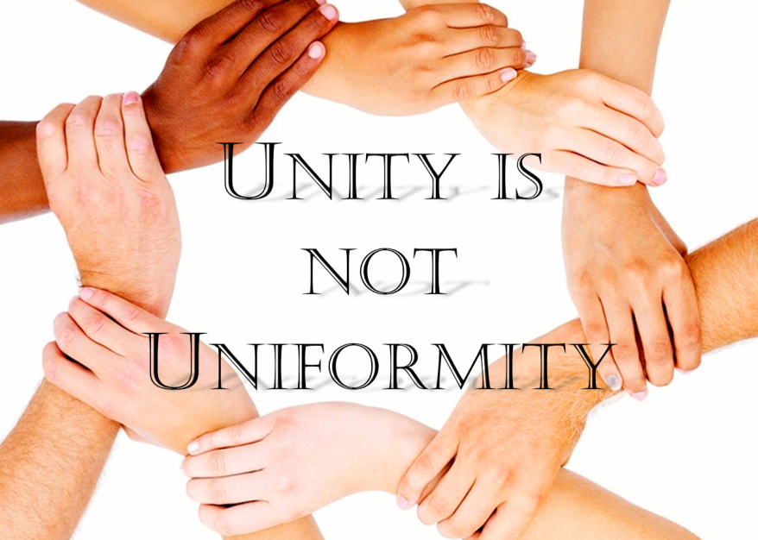
God Unifies The Church
Unity Does Not Mean Uniformity
God uses different people differently for His purposes and glory.
The first century New testament church came from various backgrounds. There were differences.
People can be different and still be united in Christ.
Congregations can even be different in style because of different cultures.
Clearly, God had a plan where local churches were autonomous. This allows for diversity.
Christians must seek to be unified in Christ, making use of the differences as strength in service to God.
Notes:
Unity does not mean uniformity. God uses different people differently for His purposes and glory. The first century New testament church came from various backgrounds. There were differences. People can be different and still be united in Christ. Congregations can even be different in style because of different cultures. Clearly, God had a plan where local churches were autonomous. This allows for diversity. Visit the congregation where this author worships and the men are often dressed in suits and ties to blue jeans. Two hours away, another congregation has many worshippers wearing leather vests and chaps at worship. This is appropriate with the motorcycles they drive to worship. This is the local culture. Decency and not standing out (immodest) is the key. Diverse populations draw diverse people to Christ. Christians must seek to be unified in Christ, making use of the differences as strength in service to God.

Slide 22
God Unifies The Church
Compromise of Doctrine Is Not Part of Unity
Children of Light are called to be of the same mind.
Division is part of Satan’s tools (1 Cor 3:1-4).
This is not a worldly commonality being emphasized.
1 Corinthians 1:10: "Now I beseech you, brethren, by the name of our Lord Jesus Christ, that ye all speak the same thing, and that there be no divisions among you; but that ye be perfectly joined together in the same mind and in the same judgment."
When some people read 1 Corinthians 1:10 and say the church must be in complete agreement on everything, they miss the point.
Consider that Paul and Barnabus disagreed in Acts 15:36-40. Or, one might also consider Romans 14 to see that differences do not mean there is not unity.

Slide 23
God Unifies The Church
1 Corinthians 9:19-23: "For though I be free from all men, yet have I made myself servant unto all, that I might gain the more. And unto the Jews I became as a Jew, that I might gain the Jews; to them that are under the law, as under the law, that I might gain them that are under the law; To them that are without law, as without law, (being not without law to God, but under the law to Christ,) that I might gain them that are without law. To the weak became I as weak, that I might gain the weak: I am made all things to all men, that I might by all means save some. And this I do for the gospel's sake, that I might be partaker thereof with you."

Slide 24

God Uses Differences
God uses difference to strengthen the church.
Jesus demonstrated use of different personalities with the Apostles.
Some folks are more like a Paul. Some are more like Peter. Some are like John. Some are like Matthew. Some are a mixture.
God can use each accordingly.
Together, differences make for greater strength. God wants His children to use their differences to be stronger collectively.
One person's weakness and a different person's strength can offset each other and vice versa such that they are stronger together.
God's differences in His saints allow the function of the church and should promote unity instead of strife.
Notes:
God uses difference to strengthen the church. Jesus demonstrated use of different personalities with the selection of the Apostles. Some folks are more like a Paul. Some are more like Peter. Some are like John. Some are like Matthew. Some are a mixture. God can use each accordingly. Together, differences make for greater strength. God wants His children to use their differences to be stronger collectively. One person's weakness and a different person's strength can offset each other and vice versa such that they are stronger together. God's differences in His saints allow the function of the church and should promote unity instead of strife.

Slide 25
God Uses Differences
Children of light cannot let ego, pride, or the “big-Me-Little-you” syndrome to develop.
If God has blessed a person with greater talents, opportunities, skills, and abilities, then there is no doubt that more shall be required if they have more.
If you have less, all He expects is for one to exercise those in His service.
Luke 12:48b explains, “For unto whomsoever much is given, of him shall be much required: and to whom men have committed much, of him they will ask the more.”

Slide 26
A variety of people were taught and obeyed the Gospel:
These very different people became one in Christ.
People can indeed do things differently and be united in Christ.
In the first century, those being converted to Christ were Jews and Gentiles.
Notes:
A variety of people were taught and obeyed the Gospel. These very different people became one in Christ. People can indeed do things differently and be united in Christ. In the first century, those being converted to Christ were Jews and Gentiles. The internet, social media, TV, telephone, and printing press were not available. Most communication was verbal or reading from a written letter. Common concepts and even the concept of deity was different among those converts. Many came from a background of idolatry with a pantheon of deities. Imagine a convert who was being taught about morality who came from an area were fertility gods were worshipped by sexual intercourse and prostitution. The Jews had often had others adding weights to their practice of worship as well. The backgrounds and cultures were very different from each other, even down to their food. The Roman world with many interacting cultures called souls from different cultures with many human differences. Unity through likeness is a human achievement, and unlikely. See Acts 2:10, Acts 10, 10:28, Acts 11:19-24

Slide 27
A variety of people were taught and obeyed the Gospel:
In the first century, those being converted to Christ were Jews and Gentiles.
Common concepts and even the concept of deity was different among those converts.
Many came from a background of idolatry with a pantheon of deities.
The backgrounds and cultures were very different from each other, even down to their food.
The Roman world with many interacting cultures called souls from different cultures with many human differences.
Unity through likeness is a human achievement, and unlikely. See Acts 2:10, Acts 10, 10:28, Acts 11:19-24
Notes:
A variety of people were taught and obeyed the Gospel. These very different people became one in Christ. People can indeed do things differently and be united in Christ. In the first century, those being converted to Christ were Jews and Gentiles. The internet, social media, TV, telephone, and printing press were not available. Most communication was verbal or reading from a written letter. Common concepts and even the concept of deity was different among those converts. Many came from a background of idolatry with a pantheon of deities. Imagine a convert who was being taught about morality who came from an area were fertility gods were worshipped by sexual intercourse and prostitution. The Jews had often had others adding weights to their practice of worship as well. The backgrounds and cultures were very different from each other, even down to their food. The Roman world with many interacting cultures called souls from different cultures with many human differences. Unity through likeness is a human achievement, and unlikely. See Acts 2:10, Acts 10, 10:28, Acts 11:19-24
27

Slide 28
Unity in Christ is different
One can have different opinions about curtain colors and meeting times and still be united in Christ. Even differences in some other matters can still exist with unity.
2 Corinthians 5:14-21 teaches that Christ died for all and through Him any can be reconciled to God.
1 Peter 2:21-24 helps one understand that Christ suffered for all, and He left His followers an example of enduring suffering.
Could one suffer a bit by giving into another's preference on some detail that really is not important?
The children of Light have unity in Christ.
This is not about speaking of the need for obedience to God or justifying some evil desire, but God unites His followers.
It is divine and not human. Romans 14

Slide 29
Unity in Christ is different
Ephesians 2:11-22 helps one understand how God achieves unity.
Paul notes the gulf between the Jews and the Gentiles before Christ’s sacrifice. Circumcision was practice as a commanded symbol of God’s covenant with His people. Before Christ the Gentiles were outside the covenant with God and without hope. This changed in Christ. God reconciled the Jewish and Gentile believers, making them one. Not by one becoming Jewish or the other becoming Gentile. God produced the peace between them. He made them part of His family. Now, both are built together on the cornerstone of Christ.

Slide 30
Unity in Christ is different
Acts 15:1-29 indicate that neither the Jewish believers or Gentile believers all understood this.
God has brought the Gentiles near and made both groups one. God did this. It was not something that the Jews and Gentiles did through uniformity.
Even though these peoples were very different, placing their trust in Jesus Christ unified them through God’s act even though it required the right attitude on their part, not through the people being alike.
Genesis 17:9-12

Slide 31
Unity in Christ is different
Christ taught that Christians were united in Him.
There is oneness in Christ and God.
In Acts 20:28-30, Paul anticipated division in the early church.
Many of the New Testament writers were dealing with divisions and dividers in the church.
Becoming united by likeness is not what God provided, but provides unity in Christ.

Slide 32
Unity in Christ is different
Romans 12:4-10 explains, "For as we have many members in one body, and all members have not the same office: So we, being many, are one body in Christ, and every one members one of another. Having then gifts differing according to the grace that is given to us, whether prophecy, let us prophesy according to the proportion of faith; Or ministry, let us wait on our ministering: or he that teacheth, on teaching; Or he that exhorteth, on exhortation: he that giveth, let him do it with simplicity; he that ruleth, with diligence; he that sheweth mercy, with cheerfulness. Let love be without dissimulation. Abhor that which is evil; cleave to that which is good. Be kindly affectioned one to another with brotherly love; in honour preferring one another."
Paul instructs Christians to use the opportunities and talents they have in Christ and to be united in Christ serving in love, giving the other preference.
Notes:
32

Slide 33
Conclusion
In 1 Corinthians 12: 4-14 before illustrating with the eye and ear, Paul also explained: "Now there are diversities of gifts, but the same Spirit. And there are differences of administrations, but the same Lord. And there are diversities of operations, but it is the same God which worketh all in all. But the manifestation of the Spirit is given to every man to profit withal. For to one is given by the Spirit the word of wisdom; to another the word of knowledge by the same Spirit; To another faith by the same Spirit; to another the gifts of healing by the same Spirit; To another the working of miracles; to another prophecy; to another discerning of spirits; to another divers kinds of tongues; to another the interpretation of tongues: But all these worketh that one and the selfsame Spirit, dividing to every man severally as he will. For as the body is one, and hath many members, and all the members of that one body, being many, are one body: so also is Christ. For by one Spirit are we all baptized into one body, whether we be Jews or Gentiles, whether we be bond or free; and have been all made to drink into one Spirit. For the body is not one member, but many."
Notes:
Conclusion
In 1 Corinthians 12: 4-14 before illustrating with the eye and ear, Paul also explained: "Now there are diversities of gifts, but the same Spirit. And there are differences of administrations, but the same Lord. And there are diversities of operations, but it is the same God which worketh all in all. But the manifestation of the Spirit is given to every man to profit withal. For to one is given by the Spirit the word of wisdom; to another the word of knowledge by the same Spirit; To another faith by the same Spirit; to another the gifts of healing by the same Spirit; To another the working of miracles; to another prophecy; to another discerning of spirits; to another divers kinds of tongues; to another the interpretation of tongues: But all these worketh that one and the selfsame Spirit, dividing to every man severally as he will. For as the body is one, and hath many members, and all the members of that one body, being many, are one body: so also is Christ. For by one Spirit are we all baptized into one body, whether we be Jews or Gentiles, whether we be bond or free; and have been all made to drink into one Spirit. For the body is not one member, but many."

Slide 34
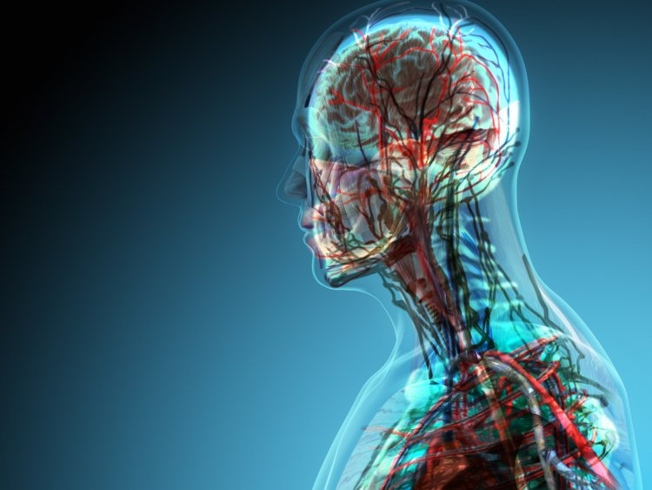
Conclusion
One might be an ear or an eye or a hand or a foot, but each has their use in the body of Christ.
One would not want to cut off their hand because it is not an eye, neither would one want to divide from a brother because they are not uniform as another brother because all the saints are united in Christ.
Together, the church is stronger as each member helps the other. Christians must worth together in love.
This oneness is not of human origin in uniformity, but oneness in Christ.
Christians must not let Satan use his dark distortion of division to blind them.
Unity accomplishes so much good in a church, while division is like a cancer.
Notes:
One might be an ear or an eye or a hand or a foot, but each has their use in the body of Christ. One would not want to cut off their hand because it is not an eye, neither would one want to divide from a brother because they are not uniform as another brother because all the saints are united in Christ. Together, the church is stronger as each member helps the other. Christians must worth together in love. This oneness is not of human origin in uniformity, but oneness in Christ. Christians must not let Satan use his dark distortion of division to blind them. Unity accomplishes so much good in a church, while division is like a cancer.
Underview
One might ask are there any acceptable divisions? Clearly, there are different roles in the work of the church as well as divisions of labor. There are also the division between the righteous and evil as Psalm 92:1-5 discusses.

